Slide 1
Affordability and Accessibility
Cate Sumner and Carolyn Graydon
Session 14, [9 March, 2023]

Slide 2
Session overview:
What does Court Performance Data tell us on access and affordability of justice?
Who is accessing the court and who is not?​
Where are they coming to court?​
How are they accessing the court? ​
What are the outcomes when people access the court?

Slide 3
The large proportion of litigants who are unable to access or afford legal advice and or representation before the Courts continues to be a matter of serious concern. Those involved in criminal and family law/protection proceedings are often the most disadvantaged. Considerable additional time and resources are required to ensure that such cases are managed efficiently and brought to trial in a timely manner while also ensuring that those parties are afforded natural justice and procedural fairness.
-Hon Chief Justice Michael H. Whitten QC of Tonga
Extract from Courts of Tonga 2020-2021 Annual Report

Slide 4
We need to have a different mental set or mentality in order to deal with the justice needs of the ordinary people of this country. The question we should ask is how the post-pandemic justice system will look different and how it might even emerge from the current crisis better than before.
Most importantly the use of digitalization will become the norm in short matters such as restraining orders protecting domestic violence victims, child protection determinations, bails applications – All by way of remote proceedings by telephone and videoconference.
-Honorable Chief Justice Vincent Lunabek of Vanuatu
Extract from Vanuatu 2022 Official Opening of the Courts.

Slide 5
How Courts engage transparently with the public on their work and demonstrate access to justice as a key element of the administration of justice

Slide 6
Access to Justice
– what are we looking for?
Who is accessing the court and who is not?
Where are they coming to court?
How are they accessing the court?
What are the outcomes when parties do access the court?
Are there some outcomes that violate human rights?

Slide 7
Are women accessing the courts?
Are children visible in court data?
Are people that live outside cities accessing the courts?
Are people that are poor accessing the courts?
Are people with disability accessing the courts?

Slide 8
When people with disabilities come to court

Slide 9
Need to focus on people with disabilities
17% (1.7m) Pacific people with some form of disability
>10% children with disabilities attend school in Asia Pacific
Only 10% Pacific people with disabilities economically active
More vulnerable to physical and sexual abuse (women & girls 2-3 x and children 4 x than others)
People with disabilities have the highest rates of dissatisfaction with court services.
EQUAL RIGHTS

Slide 10
People with disabilities have equal rights
Convention on the Rights of People with Disabilities (CRPD)
14/15 Pacific countries have signed or ratified
Key obligations which apply to Courts
Non-discrimination: right to access, understand, participate, exercise rights, as others do (Art 4)
Reasonable accommodations: must be made to avoid discrimination (Art 2)
Collect and analyse data: (Art 31)
Positive obligation to raise awareness, challenge stereotypes and prejudices towards people with disabilities (Art 4)

Slide 11
Art 31 CRPD obligations
To collect statistical and research data to enable policies to give effect to the Convention.
Data ‘shall be disaggregated’ ‘used to help assess the implementation of Convention’ and to ‘identify and address the barriers faced by persons with disabilities in exercising their rights.’
Court responsibility for dissemination of statistics to persons with disabilities and others.

Slide 12
Do you have difficulty seeing, even if wearing glasses?
Finding out as early as possible if people need extra help
Do you have difficulty hearing, even if using a hearing aid?
Do you have a disability or health condition that may affect your participation in court?
Please call us on # if any of these questions apply to you so we can discuss what assistance the court can provide. We are here to help.
Do you have difficulty walking or climbing steps?
Do you have difficulty remembering or concentrating?
Using your usual language, do you have difficulty communicating, for example understanding or being understood?
Do you have difficulty reading?

Slide 13
Key data capture points
Fields built into CTS
For both civil and criminal cases
For parties and witnesses
3 key data collection opportunities within existing court processes:
1: Time of filing (civil)/first appearance (crim)
2: Time of response (respondent, defendant, victim, witness)
3: Day of the hearing to fill any remaining data gaps
Notes:
Include many rights that courts deliver:
Equality before the law means people must have equal access to the courts to enforce their rights
Right to a fair and speedy trial. Justice delayed is justice denied.
Right to an effective remedy
Right to be treated as innocent until proven guilty: those held in pretrial detention have right to be held only as a matter of last resort and for the shortest possible time.

Slide 14
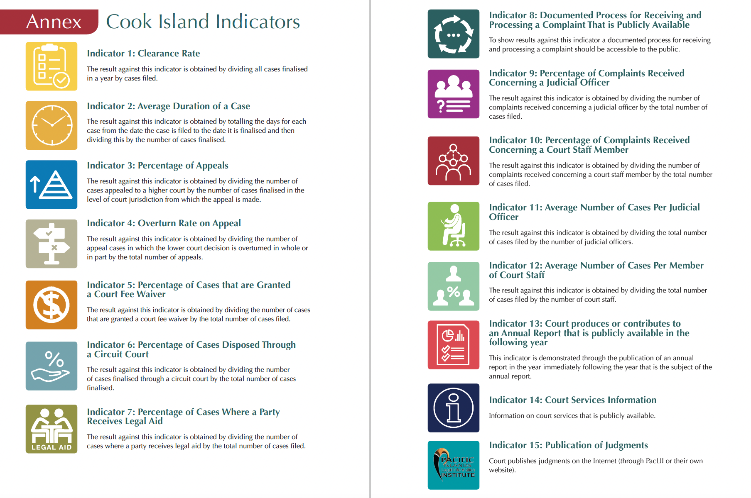

Slide 15
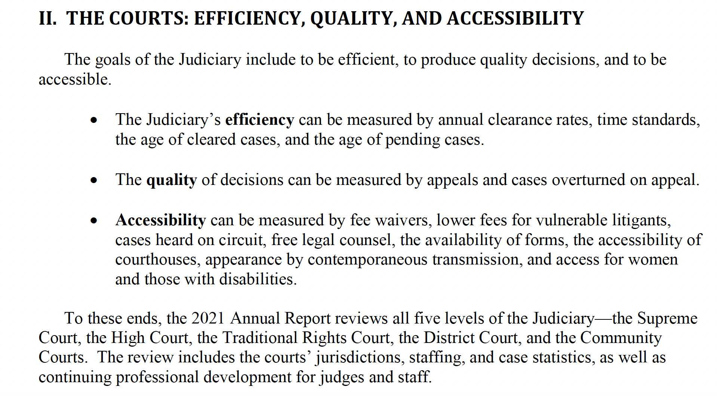
Extract from 2021 Annual Report: Republic of the Marshall Islands p16.

Slide 16
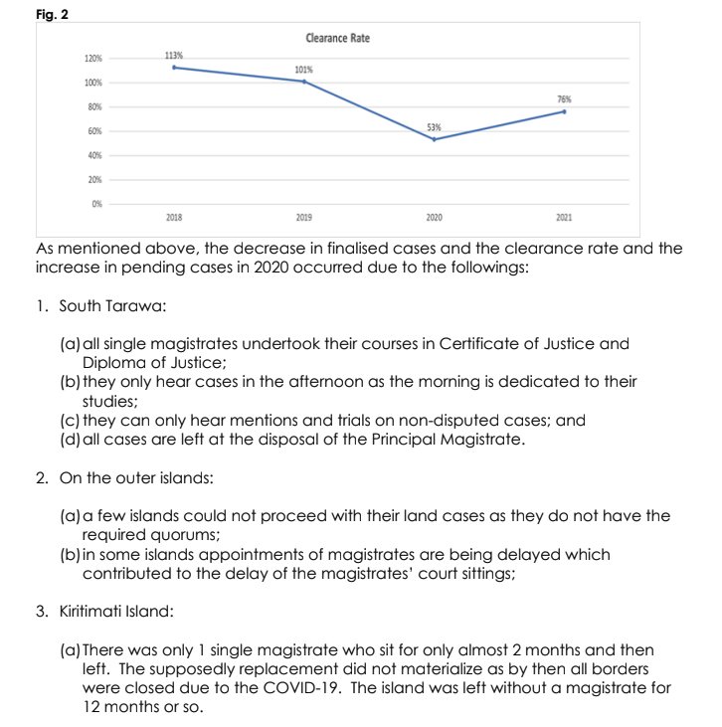
Case management data
Shows us whether the court has capacity to effectively manage its caseload and make good decisions
Allows barriers to be identified and addressed
Extract from Kiribati Judiciary Annual Report: High Court Division 2020-2021, Magistrates Court Division 2018-2021 and Corporate Services Division 2020-2021, p41.

Slide 17
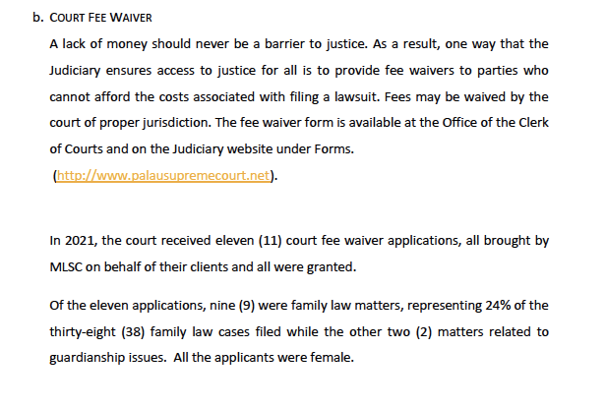
Affordability and accessibility data
Shows us whether people can access the courts despite cost and distance
Extract from Palau 2021 Annual Report (Access to Justice as COVID-19 Challenges Continue), p49.

Slide 18
Affordability and accessibility data
Shows us whether people can access the courts despite cost and distance
(Note: Miscellaneous Applications compromise of protection order cases)
Allows for gaps to be identified in certain areas or regions
Extract from Kiribati Judiciary Annual Report: High Court Division 2020-2021, Magistrates Court Division 2018-2021 and Corporate Services Division 2020-2021, p49-50.

Slide 19
Affordability and accessibility data
Shows us whether people can access the courts despite cost and distance
Recording data on remote court appearances shows how people are accessing the court
Extract from Palau 2021 Annual Report (Access to Justice as COVID-19 Challenges Continue) p49.

Slide 20
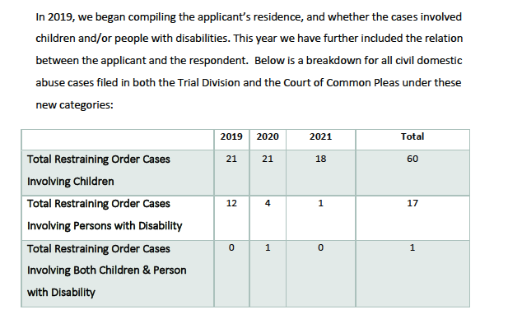
Sex, age and disability disaggregated data
Shows us whether women, children and people with disability are accessing the courts
Extract from Palau 2021 Annual Report (Access to Justice as COVID-19 Challenges Continue) p38-39.

Slide 21
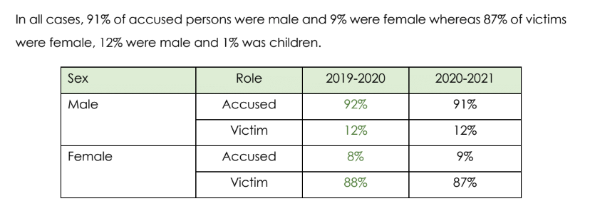
Sex, age and disability disaggregated data
Extract from Courts of Tonga Annual Report 2020-2021 p63-64.

Slide 22
Pathways to court
Shows us how people are able to access the court
Extract from Courts of Tonga Annual Report 2020-2021 pp 64-65.

Slide 23
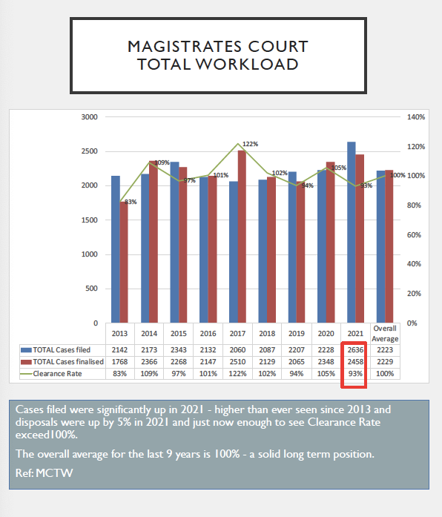
Example: Vanuatu 2021 Annual Statistics

Slide 24
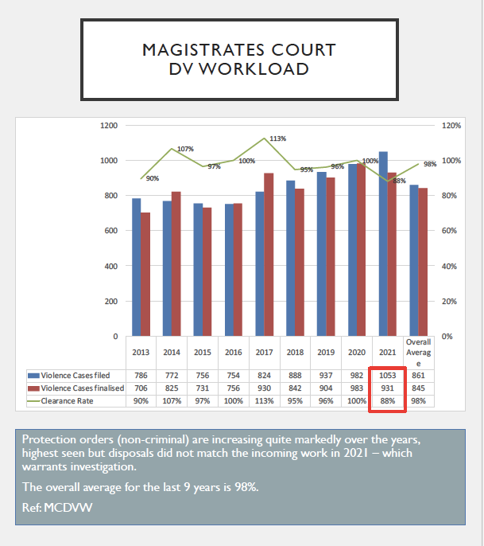
Example: Vanuatu 2021 Annual Statistics Protection Order Data
Example of how data can be used to identify areas that need attention

Slide 25
Vanuatu 2023 Official Opening of the Court
10 Active Magistrates in 2022
Management of cases through remote technology
The Magistrates were able to hear and dispose of cases via true conference and telephone conferences. As a result, we have seen an increase in number of DV applications from remote areas seeking protection orders from the court.
Remarks by the Honorable Chief Justice Lunabek

Slide 26
Presenting data on FPA Cases

Slide 27
10 years on since signing the Pacific Leaders Gender Equality Declaration
Leaders expressed ‘deep concern that …overall progress in the region toward gender equality is slow.’
And that …’violence against women is unacceptably high.’

Slide 28
Pacific Leaders Gender Equality Declaration 2012
Relevant Policy Actions
Produce and use sex disaggregated data
Implement progressively essential services including legal services for survivors
of violence
Impose appropriate penalties for perpetrators of violence
Court responses
Publish sex disaggregated data on Family Protection Act, other cases involving VAW and girls
Publish information on court cases brought by legal aid services available to survivors of violence
Publish data on outcomes in Family Protection Act and other violence cases involving women and girls

Slide 29
Regional Ending Violence Against Women and Girls (EVAWG)
Services Symposium August 2022

Slide 30
Over a million women and girls (15+) affected by violence in Pacific each year versus court annual reports show only 1250 protection order cases
Global average partner violence against women over their lifetime: 30%
Pacific rates higher, some 60+% (based on 12 Pacific countries with data)
Without transparency of key data on protection order and family violence cases it is very difficult for countries to measure progress against National Plans on Ending Family Violence and Ending Violence Against Women and Girls as well as the actions outlined in the Pacific Leaders Gender Equality Declaration.​
Source: The Pacific Communities Pacific Data Hub http://pacificdata.org/ population and SDG5 dashboards
Regional perspective: Scale of the problem…

Slide 31
Previous 12 months: Partner violence, women and girls 15+
Country | %, in 1 year affected | Total women & girls 15+ | Estimated total incidents | # PO cases filed in Annual Reports | % filed for PO
Cook Is. | 14% | 6000 | 833 | No data yet
FSM | 21% | 35,600 | 7,514 | No data yet
Fiji | 23% | 320,200 | 74,291 | No data yet
Kiribati | 25% | 41,700 | 10,518 | 9 (2021) | .08%
Palau | 14% | 6800 | 942 | 67 (2020) | 7.1%
PNG | 30% | 2.86 m | 877,730 | No data
RMI | 19% | 17,300 | 3,343 | 4 (2020) | .12%
Nauru | 20% | 3600 | 743 | No data yet
Samoa | 32% | 59,400 | 19,027 | No data yet
Sol Is. | 28% | 227,300 | 63,889 | No data yet
Tonga | 21% | 33,200 | 6825 | 157 (20/21) | 2.3%
Vanuatu | 29% | 92,700 | 28,585 | 1053 (2021) | 3.68%

Slide 32
Family Protection Data: 10 Indicators
1 |  | Cases filed, finalised and clearance rates including type of protection order (interim/ final) and location ( by registry/ island)
2 |  | Sex/gender disaggregated data for the applicant and respondent in protection order cases
3 |  | Family Protection Act cases as a % of total cases filed in the Magistrates Court
4 |  | Average duration of a protection order case – interim/ final/ total cases and disaggregated by registry
5 |  | Outcomes in protection order cases: Granted/ not granted/ withdrawn (for both final or interim protection orders) conditions that were included in protection orders for contact, custody of children, maintenance, residence

Slide 33
Family Protection Act: 10 Indicators
6 |  | Number of cases in which any of the parties in a protection order case indicate they have a disability
7 |  | Number of cases where assistance provided to file protection order applications and who assisted: Women’s Centre/ Police/ Authorised persons/ Public solicitor/ private lawyer
8 |  | Relationship between the parties: intimate partner, other family member
9 |  | Number of protection order cases filed and/ or heard remotely including type of protection order (interim/ final)
10 |  | Number of breaches of protection order; family violence offences; penal code offences involving a family member.

Slide 34
2021: Palau Family Protection Act cases update
1 |  | 69 restraining order cases were filed in 2021, 71 cases finalized with a clearance rate of 103%. The trend clearance rate for restraining order cases has not fallen below 94% in the last five years.
2 |  | Restraining order cases made up 8% of total cases filed in the Court of Common Pleas. Note: citation cases that are paid at court and not heard by a judge are excluded from this calculation.
3 |  | The average duration of a final restraining order case was 16 days.
4 |  | 77% of applicants in restraining order cases were female, whilst 20% were male and 3% were filed jointly by male and female applicants. The proportion of female applicants is up from 2019 and 2020, where women made up 43% and 48% of applicants, respectively.

Slide 35
2021: Palau Family Protection Act cases update
5 |  | Only 1 restraining order case was reported to involve a person with disability. This is down from 4 cases in 2020, and 12 in 2019.
6 |  | Majority of applicants and respondents were or had been in a dating relationship (36%) or were related (35%).
7 |  | 84% of applications for temporary restraining orders and 77% of applications for final restraining orders were granted. This is down from previous years.
8 |  | 53 criminal charges were filed under the Family Protection Act. Whilst this is lower than 2020 (where there 66 criminal charges filed), there is a general trend towards the number of charges increasing.

Slide 36
2020/2021 Tonga Family Protection Case Update
1 |  | 157 protection order cases were filed between 1 July 2020 and 30 June 2021, with a clearance rate of 115%. The trend clearance rate for protection order cases has not fallen below 103% in the period since 2018. The majority of applications are heard at Ha’apai and Vava’u.
2 |  | 77% of applicants in protection order cases were female, whilst 19% were male and 4% were jointly filed by male an female applicants. This proportion of female applicants is similar to 2019-2020.
3 |  | Protection order cases represented 1.24% of the cases filed in the Magistrates Court. This is a slight decrease from recent years.
4 |  | The average duration of a protection order case was 52 days. The average varies between registries and ranges from 36 days (Ha’apai) to 83 days (Tongatapu). Note: the data does distinguish between protection order types.

Slide 37
2020/2021 Tonga Family Protection Case Update
5 |  | The majority of protection order applications were granted, irrespective of the type of order sought. The proportion of applications refused did not exceed 12% for any type of protection order.
6 |  | Almost half the applicants in protection order cases in the Nuku’alofa registry were not assisted with the registration of their cases. However 49% of applicants were assisted by the Tonga Family Protection Legal Aid Centre.
7 |  | The most common relationship between the applicant and respondent is parents of a child (40%). In another 25% of applications, the applicant and respondent were married.

Slide 38
Country Exercise
Work as a country team to create or update the the full FPA case data update.
You have been given the template for this document and can work on it in the first part of the week
Consider the following issues and make notes on the following
Which of the 10 FPA data sets is hardest to present
Who could the court work with to be able to strengthen collection and presentation of the data
What did you find interesting in the way your ‘partner’ collected or presented data?
Is there something you have seen that you would like to try and add to the FPA updates when you return?
Who will you share this document with upon your return both within and outside the court?
Any other points that you think are important about FPA cases that you would like to add?
Each country is to make a 10-minute presentation of its FPA country report to a country that it has been paired with.
Present back to the group in a 5-minute presentation by the ‘other’ country.
Notes:
This will use the court data management skills from the first part of the workshop

Slide 39
Juvenile case data exercise

Slide 40
Juvenile Case Data: 10 Indicators
 |  | Cases filed, finalised and clearance rates and location ( by registry/ island)
 |  | Age: Date of birth, age at time of alleged offence and current age of suspect. Ages of victim/s, witnesses Sex: disaggregated data for the suspect, victim/s, witnesses Disability disaggregated data for the suspect, victim/s, witnesses
 |  | Type of charge and % of juvenile cases of total cases filed in the Magistrates Court Bail granted : conditions Pre-trial detention: duration (ongoing and total), location (separated from adults?)

Slide 41
Juvenile Case Data: 10 Indicators
 |  | Outcomes and sentence in juvenile cases: Diversion/Dismissal Non-conviction/Conviction Sentence: Custodial: Duration, suspension, location (separated from adults?) Non-custodial: Conditions Average duration of a juvenile case – and disaggregated by registry
 |  | Number of cases where juvenile was legally represented (public or private lawyer)
 |  | Appeal from primary decision Y/N and outcome
 |  | Number of breaches of protection order; family violence offences; penal code offences involving a family member.

Slide 42
Country Exercise: Juvenile Data
Work as a country team to create or update juvenile case data
Use the same template as FPA cases but include field on pre-trial detention
Consider the following issues and make notes on the following
Which of the 10 data sets is hardest to present?
Who could the court work with to strengthen collection and presentation of the data?
What did you find interesting in the way your ‘partner’ collected or presented data?
Is there something you have seen that you would like to try and add to juvenile data updates when you return?
Who will you share this document with upon your return both within and outside the court?
Any other points that you think are important about juvenile cases that you would like to add?
Each country is to make a 10-minute presentation of its juvenile country report to a country that it has been paired with.
Present back to the group in a 5-minute presentation by the ‘other’ country.
Notes:
This will use the court data management skills from the first part of the workshop

Slide 43
Key Reflection Points
How can your court include and/or strengthen publication of data on:
cases filed/ finalised by registry
cases finalised at a circuit court
cases where the court fee is waived
cases where legal representation or assistance provided
collection of sex, age and disability data

Slide 44
Wrap up and thank you for attending

