Slide 1
Annual Reporting Overview
Cate Sumner
Session 13, 9 March, 2023

Slide 2
Overview of Session
Why publish Annual Reports?
Who is the Audience?
Who collaborates in producing an Annual Report and over what time period?
What should be included in the Annual Report for this audience?
Communicating the Annual Report to the target audience – how?
Other means of communicating data – monthly updates/ thematic overviews

Slide 4
Overview of Annual Reporting in the Pacific: 2011 to 2021
In the baseline year of 2011, only the judiciaries of the Marshall Islands and Vanuatu published an annual report each year and only the Marshall Islands judiciary produced an Annual Report that was publicly available through the court’s website or PacLII.
In 2022, eight judiciaries published an annual report for the previous year and almost all of these were available through the court’s website or PacLII.
The judiciaries are:
FSM
Kiribati
Marshall Islands
[Niue]
Palau
PNG
Vanuatu
Tonga [Note: Does not yet appear to be publicly available.]

Slide 5
Why publish Annual Reports?
Policy developments in the Pacific and globally suggest that judicial annual reports could be strengthened to provide evidence that courts are demonstrating the principles contained in their Mission and Vision Statements, namely:
the delivery of justice that is fair and accessible to all

Slide 6
Why publish Annual Reports?

Slide 7
The Judiciary is responsible for progressing areas that needs more development and is obliged to continue support the fundamental principles of equity and fairness while protecting the dignity and rights of our people. I also hope that this 2021 reflection will contribute to the wider conversation beyond the courts and stimulate discussions that would strengthen the justice system of Vanuatu, resulting in improved service delivery to the Republic of Vanuatu.
-Honorable Chief Justice Vincent Lunabek of Vanuatu
Extract from Vanuatu Courts Annual Statistics 2021

Slide 8
Again, as we begin a New Legal Year, we join together and reflect on the workloads and performances of the courts in the past legal years and look back to the good things, the bad things and the challenges Vanuatu Courts have gone through in respect to the work of the courts, the development of the law in general and all other developments in our society as to how the laws impacted on the life of our people and Vanuatu as a nation. We must then reflect back on these achievements, values, strengths and weaknesses. We must stand and continue with our vision of:
“A judiciary that is independent, effective and efficient, and worthy of public trust and confidence, and a legal profession that provides quality ethical, accessible and cost-effective legal services to our people and is willing and able to answer the call to public service”
-Honorable Chief Justice Vincent Lunabek of Vanuatu
Extract from Vanuatu Courts Annual Statistics 2021

Slide 9
Who is the audience?
Citizens
CSOs
Government Ministries
Parliament
Court staff and judges

Slide 11
What should be included: Cook Island Indictors
Trend data – 3-5 years if possible
For each Cook Island indicator there may be three narrative sentences or points that the court may wish to set out:
If your court has developed time standards or a performance goal for that indicator then this is presented.
The performance for the last year is mentioned and its relationship to the goal and the trend over the last 3-5 years is elaborated.
An explanation of reasons contributing to a particular performance result and how the court intends to address this.

Slide 12
How is it produced?
Publication of an Annual Report each year.
A strategic presentation of a sub-set of the data that the court leadership will be reviewing regularly throughout the year (15 Cook Island indicators)
Start small with trend data and expand over time as resources allow.
Collaborate with other organisations.
Look at how your colleagues in other jurisdictions are changing Annual Reports over time.
Seek feed-back at regular intervals.

Slide 13
Communicating Annual Reports to target Audiences?
State of the Law/ Opening Law Year Annual Address
Annual Report launch
Distribution of Annual Reports to key stakeholders
1-page thematic updates and Court User/ Multistakeholder discussions
Monthly Updates – Fiji ODPP example

Slide 14
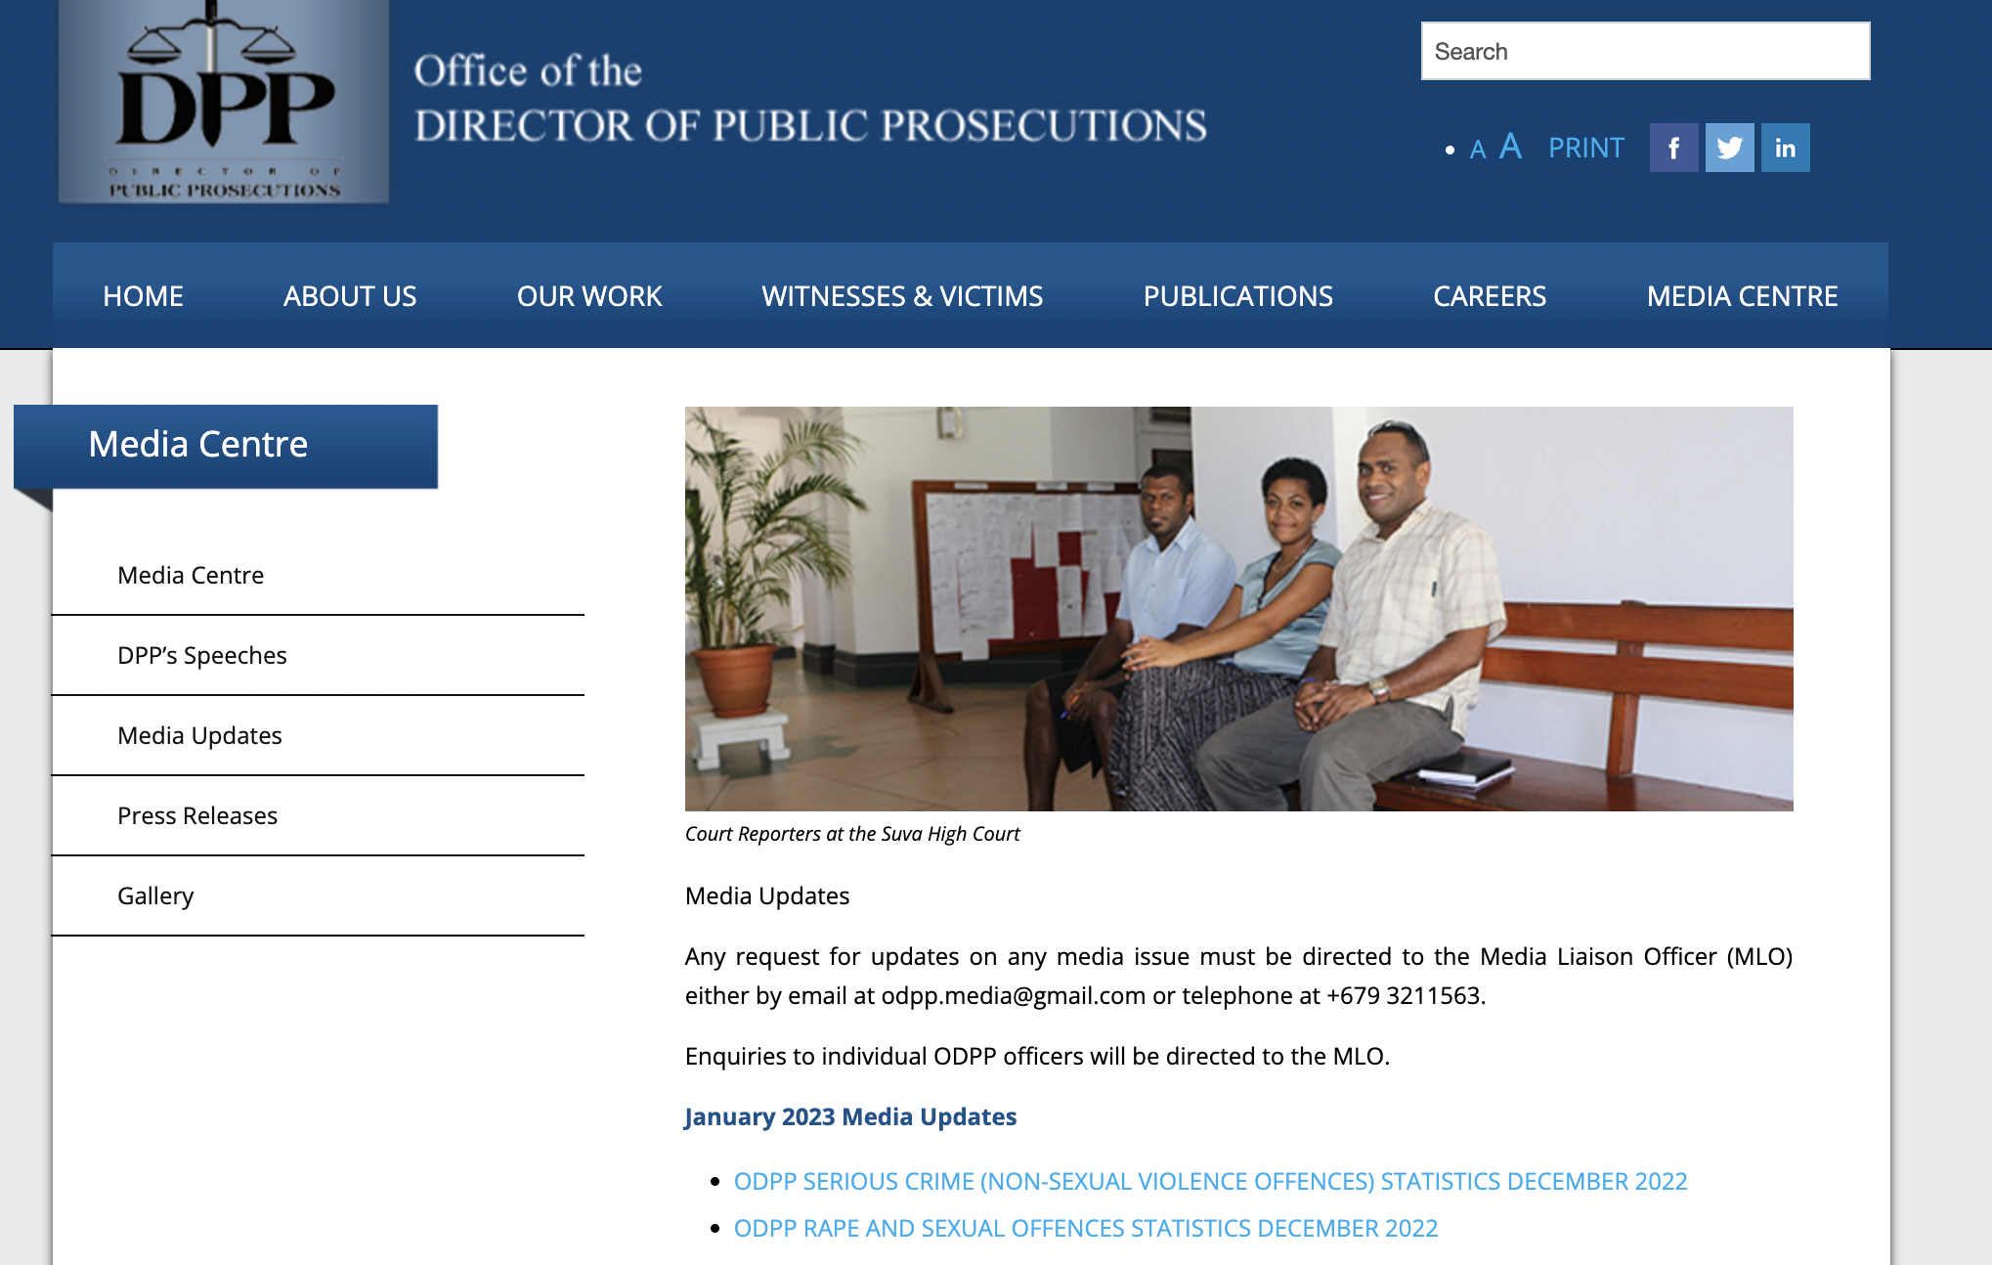
Communicating Annual Reports to Target Audiences?

Slide 15
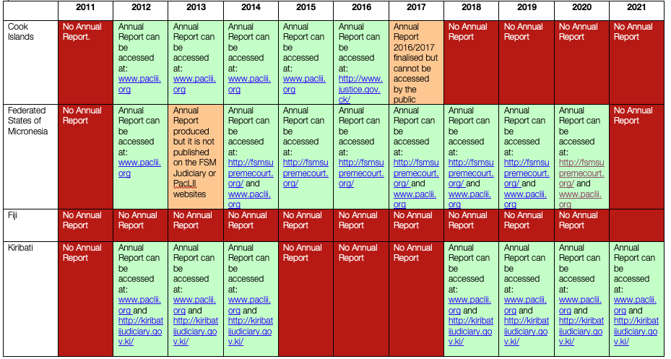

Slide 16
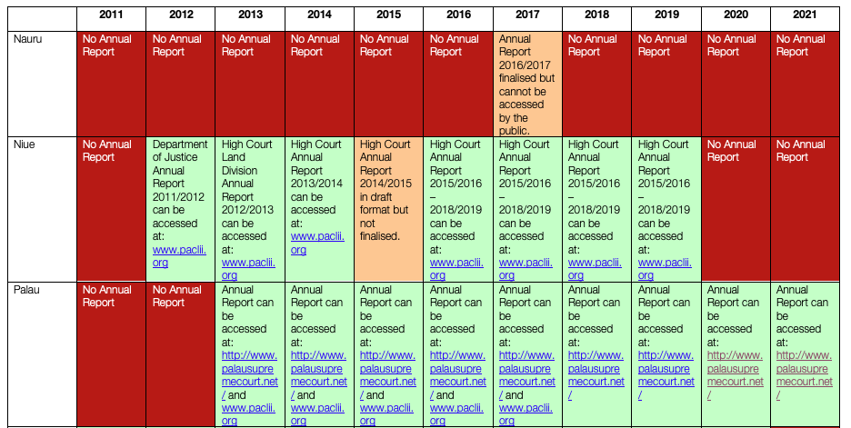

Slide 17
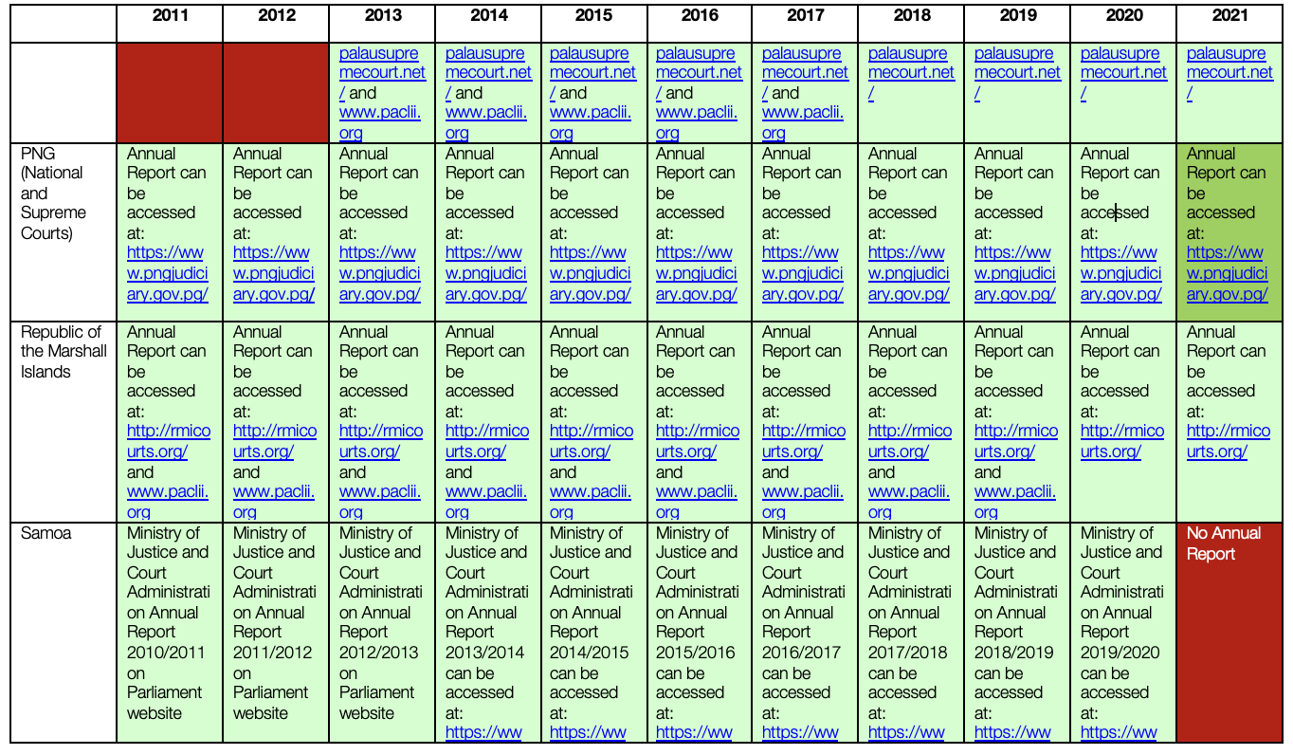

Slide 18
