Slide 1
Court User Surveys, Annual Report Challenges and Next Steps
Cate Sumner
Session 16, [9 March 2023]

Slide 2
Overview
Who are court users
Why are court user surveys important
How to undertake a court user survey
Challenges and Next Steps

Slide 3
What are the different types of court users?
Different categories of court users
Land
Barrier
Case Type
Civil
Complexity
Vulnerability
Cost
Family
Distance
Protection
Children
Criminal
Women & other FV Victims
People with disability

Slide 4
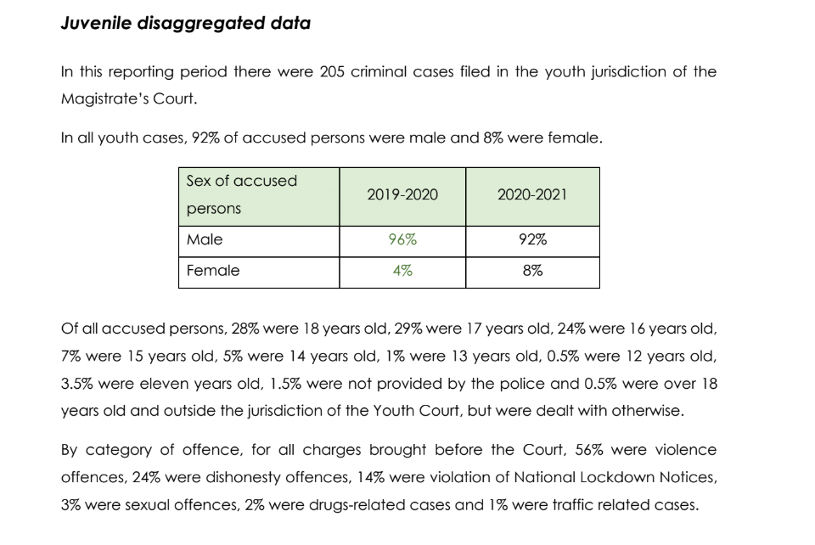
Reporting on different types of court users
Annual Reports can show how the court is responding to different categories of vulnerable court users
Extract from Courts of Tonga Annual Report 2020-2021

Slide 5
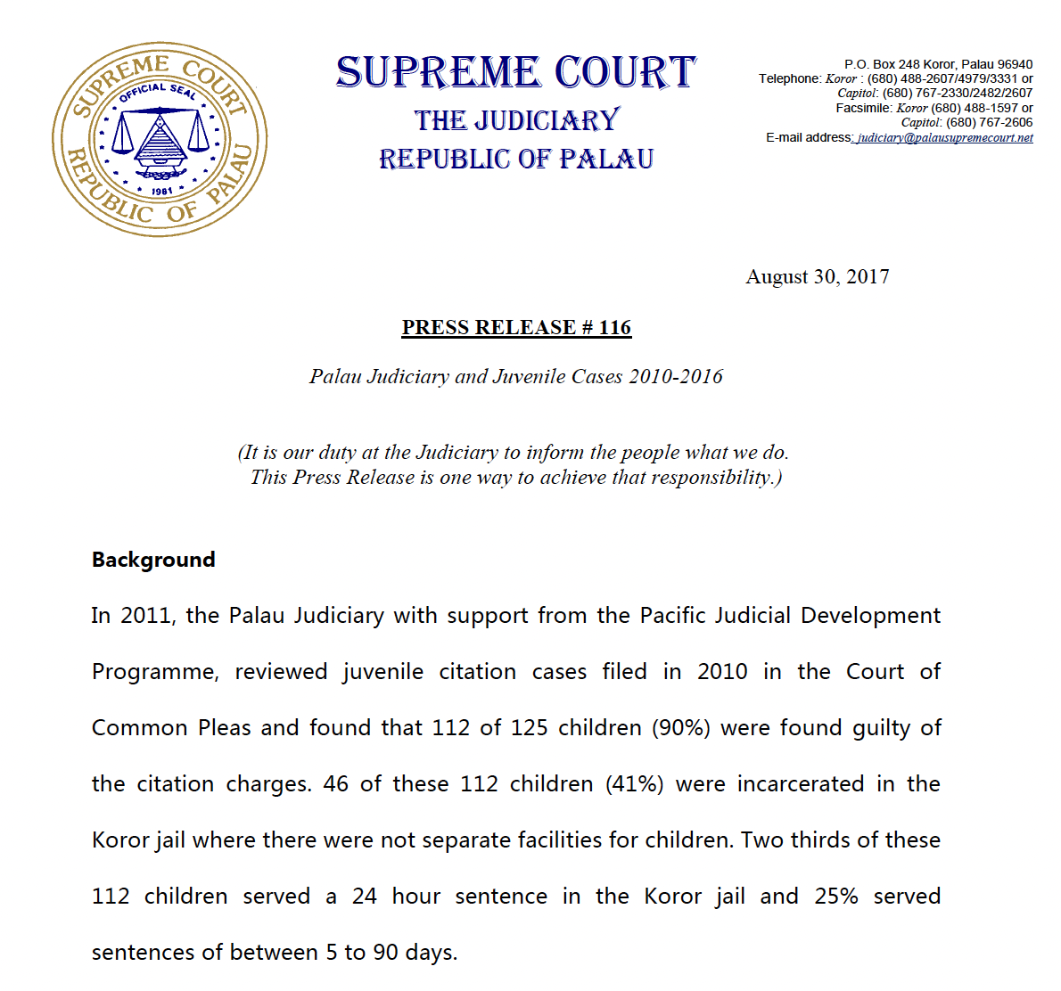
Reporting on different types of court users
Annual Reports can show how the court is responding to different categories of vulnerable court users
Extract from Palau Judiciary Press release

Slide 6
Why are court user surveys important?
Like Annual Reports, court user surveys allow courts to monitor and evaluate their capacity, and identify areas of improvement.
Courts can better understand the perceptions of court users on the quality of service provided to them, and the areas that court users would like to see improved.
Courts can monitor and evaluate court performance at a number of levels, including at the level of:
an individual court;
all courts within a state, province or sub-national region; and
all courts within a country.

Slide 7
Extract from PJSI 2020 Court Trend Report, p 26.

Slide 8
Benefits of court user surveys
Court demonstrates interest in the views of court users, CSOs and other stakeholders.
Court users tend to have more positive views than the general public. Publishing findings from court user surveys can present a more positive picture of the court.
Court users can provide valuable suggestions on how services can be improved.
Court can use data to set meaningful performance standards.

Slide 9
How to undertake a court user survey
The International Framework for Court Excellence identifies seven areas of court excellence
A court user survey should be designed to evaluate the ‘Results dimensions’ of the international framework
Seven Areas of Excellence
Driver
Systems and Enablers
Results
Court Leadership
Strategic Court Management
Court User Engagement
Court Workforce
Affordable and accessible Court Services
Court Infrastructure, Proceedings and Processes
Public Trust and Confidence

Slide 10
Key steps
Develop survey instrument
Translate into language
Seek feedback on survey instrument from local CSOs
Select database and enter survey questions to allow for data to be entered (eg, Survey Monkey, Google Forms)
Train surveyors: aim of survey, how to ask questions and how to enter data
Agree on scope of survey respondents
Undertake court user survey
Review and publish findings

Slide 11
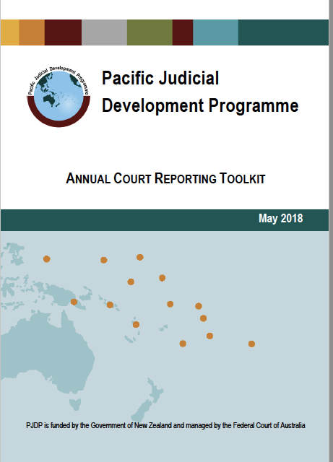
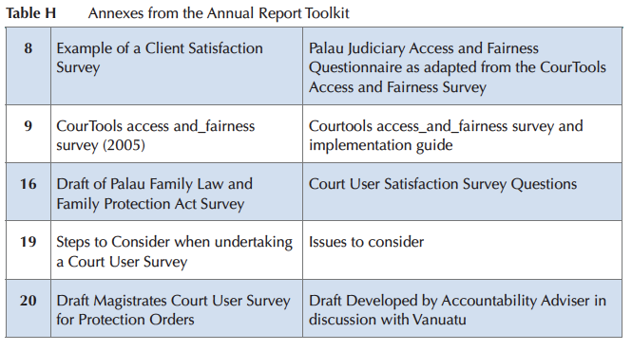
PSJI Court Annual Report Toolkit
Includes tools to assist courts considering conducting a court user survey:

Slide 12
PJSP court user surveys
 | 2011 | 2012 | 2013 | 2014 | 2015 | 2016 | 2017 | 2018 | 2019 | 2020 | 2021 | 2022
FSM
Kiribati
Palau
PNG
RMI
Tonga
Vanuatu

Slide 13
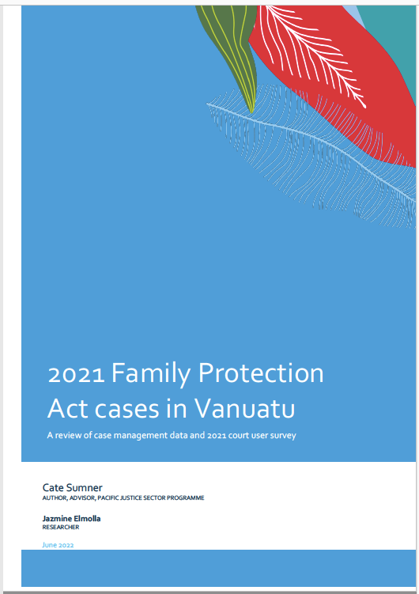
Example: Vanuatu Court User Survey
During 2021, the Vanuatu judiciary worked with the PJSI Accountability Adviser to develop:​
A survey instrument for the Magistrates Court that would have a focus on protection order cases ​
A survey instrument for the Supreme Court ​
A planning guide for conducting the court user surveys​
The court user surveys were conducted between 15 -26 November 2021 targeting 4 different islands in 6 different locations.​
​The Vanuatu judiciary collaborated with University of the South Pacific students to assist with survey at each location. ​
FPA case data trends reviewed and considered in light of court user survey findings

Slide 14
Vanuatu Census Data
Urban
22%
Rural
78%
Population

Slide 15
Vanuatu Census Data
71% of protection order cases in 2021 were filed in urban areas
22%
Urban
78%
Rural
Only 4% of cases come from outside locations with permanent court registries
Population
Protection order cases

Slide 16
Vanuatu Census Data
22%
Urban
71%
78%
Rural
4%
This data is important as it shows that very few women outside urban areas are able to access family protection remedies, despite the Family Protection Act allowing for remote filing of protection order cases to increase access.

Slide 17
Example: Vanuatu Court User Survey

Slide 18
Examples of targeted court user surveys
2017 Fiji Women’s Rights Movement and Fiji Courts
2018 RMI Access and Fairness Survey
2019 PNG Protection Order Study

Slide 19
Example: RMI Access and Fairness Survey
Over two weeks from November 5 to 16, 2018, the Judiciary conducted a user survey at both the Majuro Courthouse and the Ebeye Courthouse.
The Majuro Courthouse had 78 survey participants, and the Ebeye Courthouse had 12.
The survey results are attached as Appendix 4 of the RMI Annual Report. “We were pleased to learn that, as in past years, court users rate the judiciary high on both access and fairness.”

Slide 20
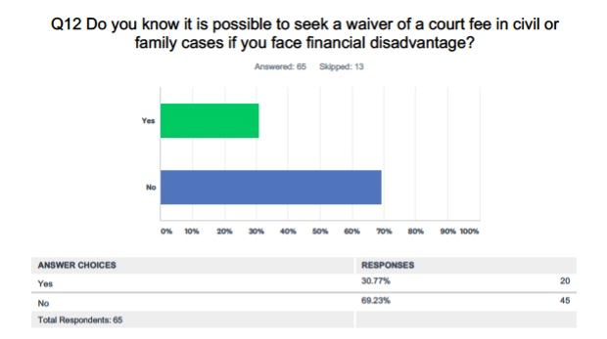
Example: RMI Access and Fairness Survey

Slide 21
Example: RMI Access and Fairness Survey

Slide 22
Exercise: Challenges and Next Steps
What data has your court had difficulty in presenting in the Annual Report?
How will they address/ overcome these difficulties?
What additional information your court seek to present in the next Annual Report? For example:
Family Protection Act Cases – how can these appear in the 2022 Annual Report?
Consider parties and their vulnerability/ invisibility and how their participation in court can be documented in an Annual Report
How will you change how you communicate the Annual Report to stakeholders within your country?
Using FPA case update documents

Slide 24
Country Exercise
Consider the value of undertaking a:
a specialized client user survey; or
access and fairness survey.
What steps are needed?
Who would you talk to inside and outside the court?
When might this survey be able to be implemented?
What might you need assistance with?

